Slide 1
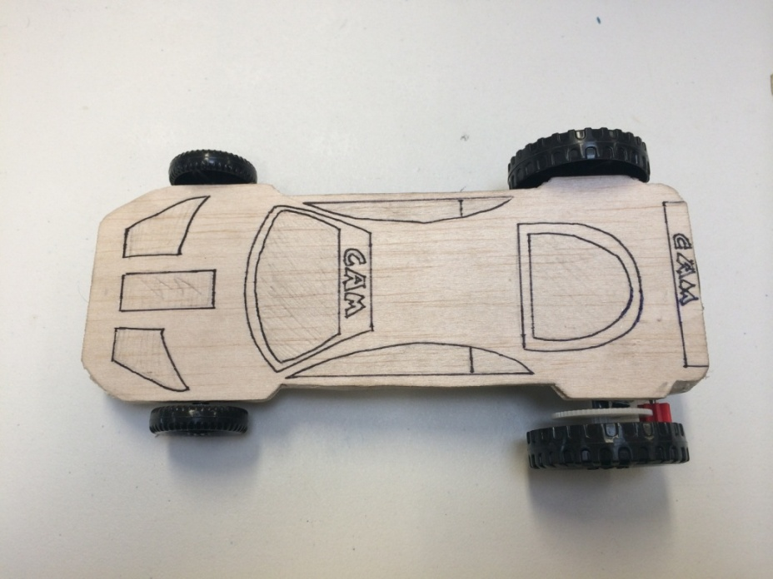
BATTERY POWERED CAR KIT 28CKIT1 (ASSEMBLY INTRUCTIONS)

Slide 2
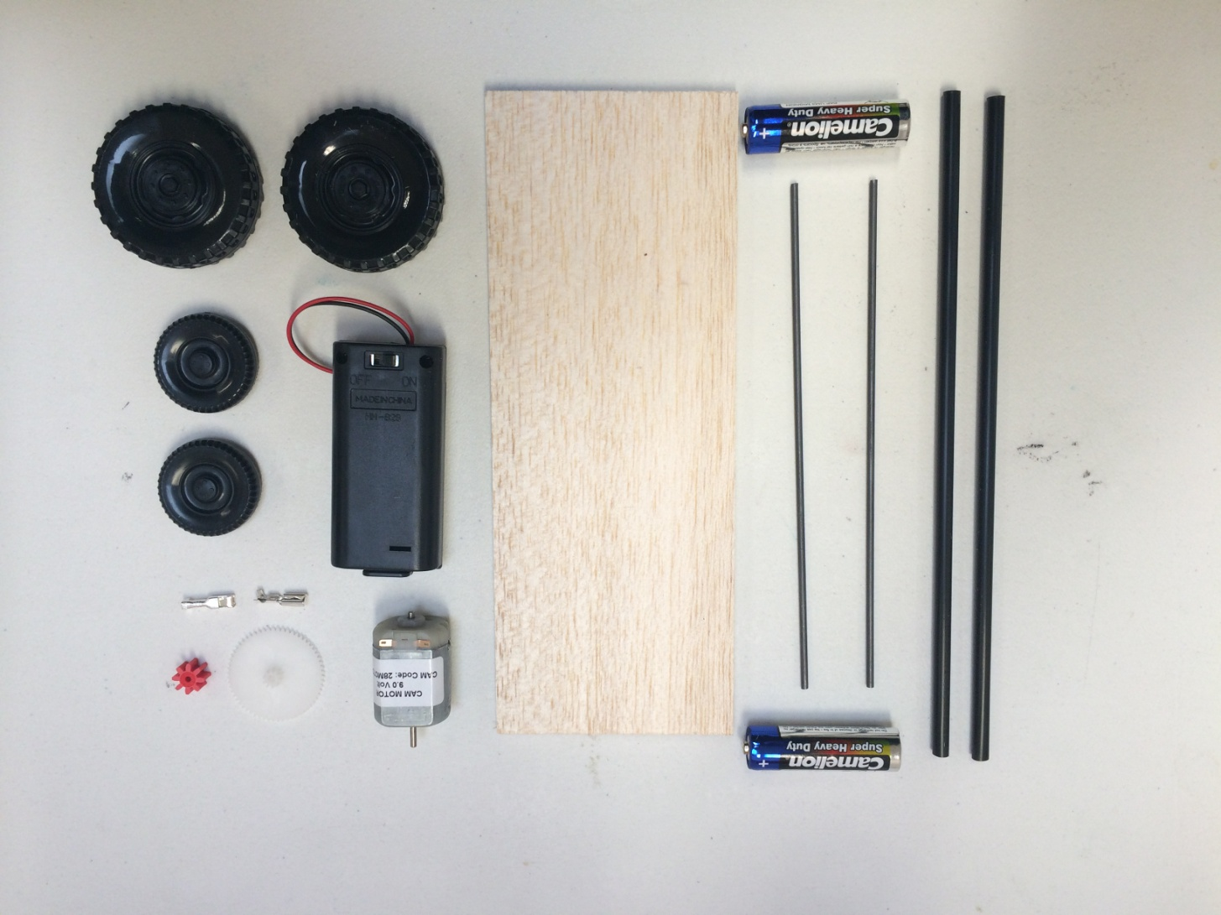
Contents of Kit

Slide 3
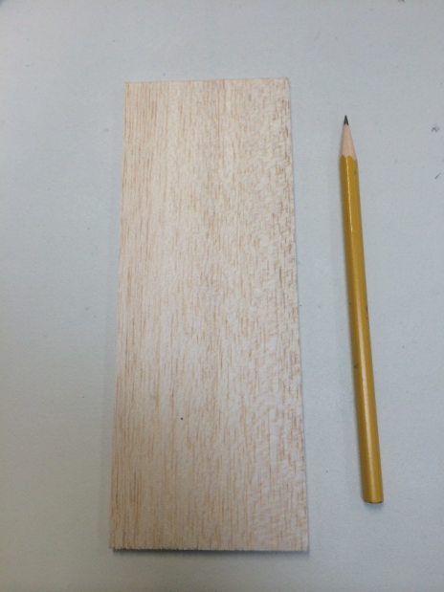
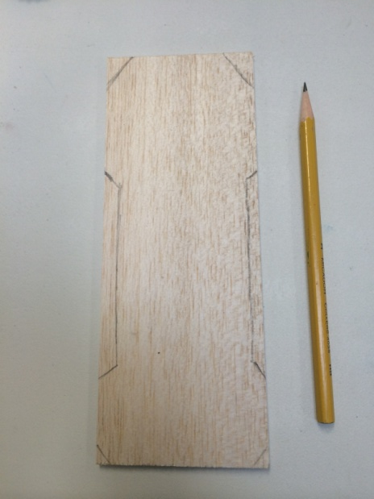
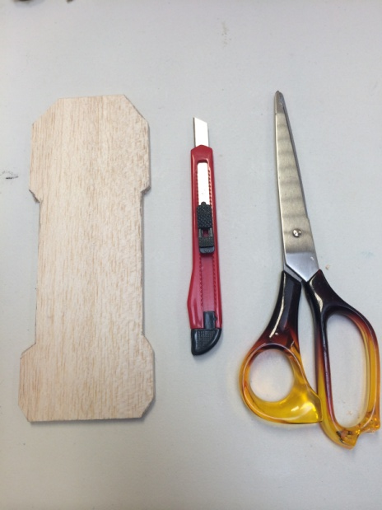
Design the shape of your car onto the Balsa Wood chassis.
Use pencil to draw car outline onto the rectangular Balsa chassis.
Cut out the car shape from your chassis using scissors & hobby knife.
You now have the body of your car ready to use.

Slide 4
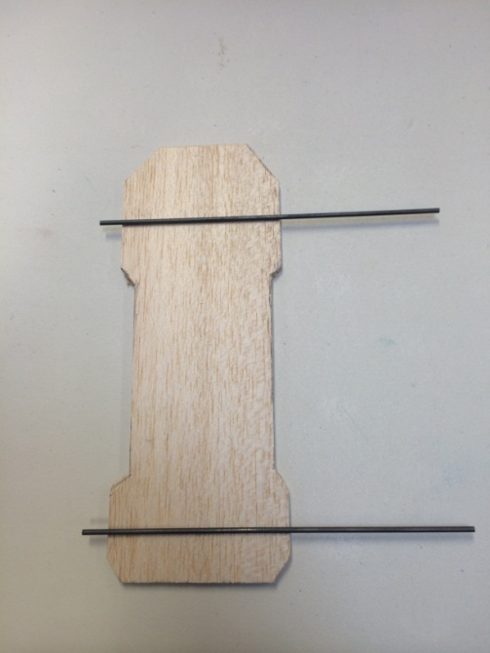
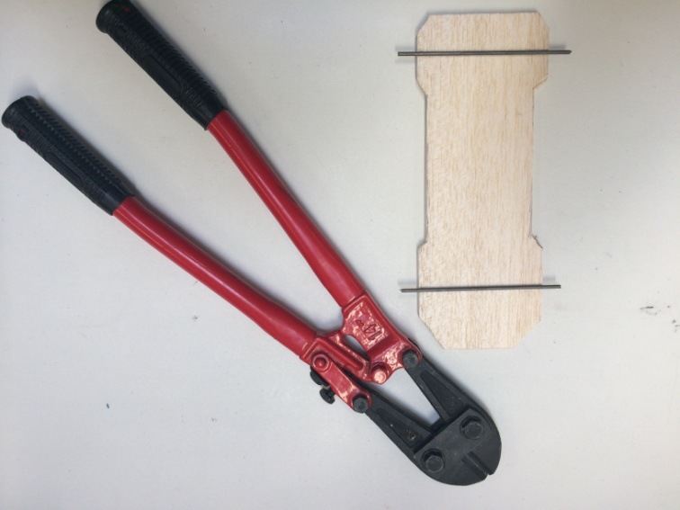
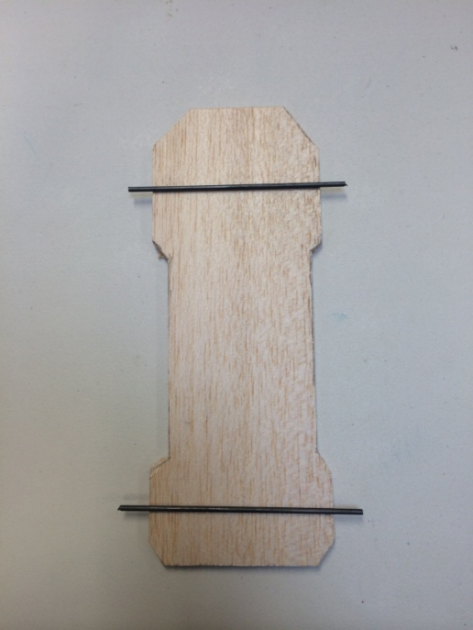
Place metal axles over the wheel position of your car & trim with bolt cutters.
Metal axle should poke out 1cm from each side of the wheel.
Make sure the axle is straight using a ruler

Slide 5
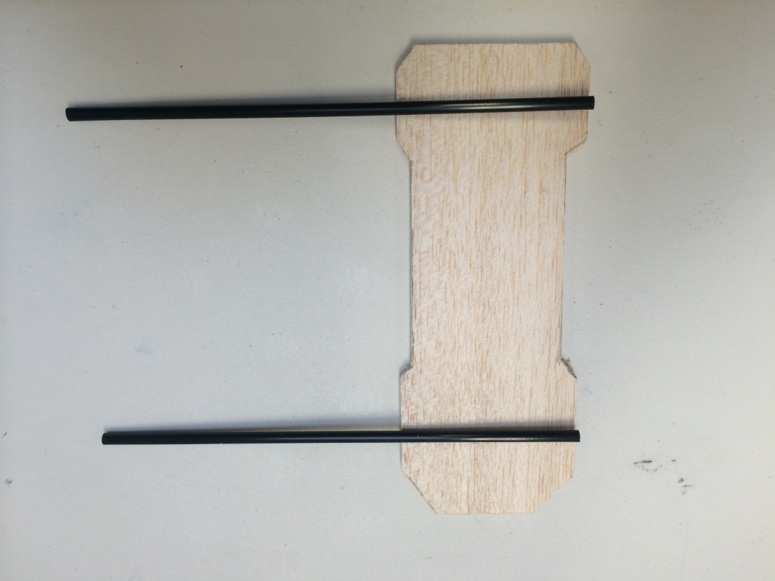
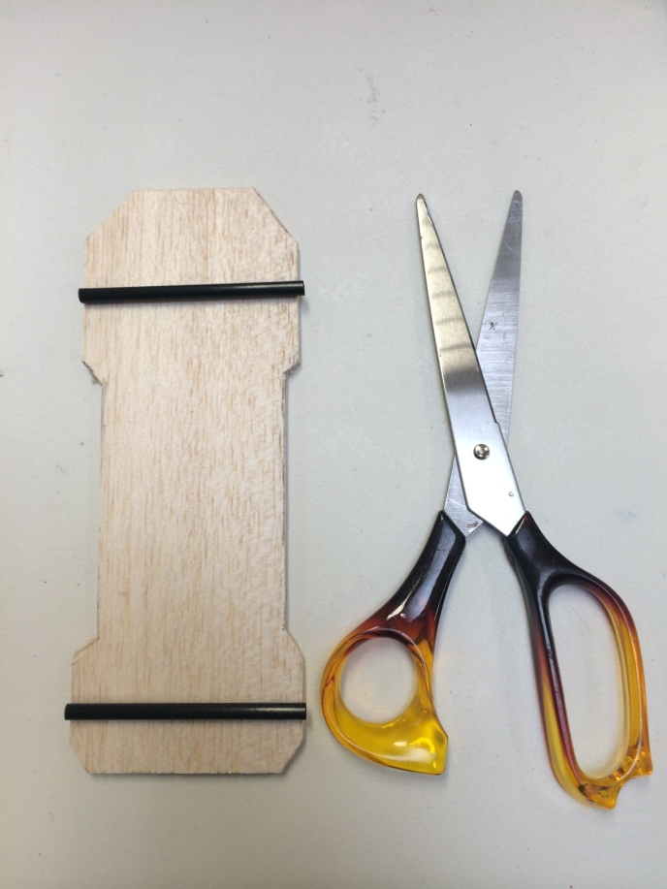
Place plastic straws over the car base & cut with scissors.
The straw should be the same as the width of the chassis base.

Slide 6
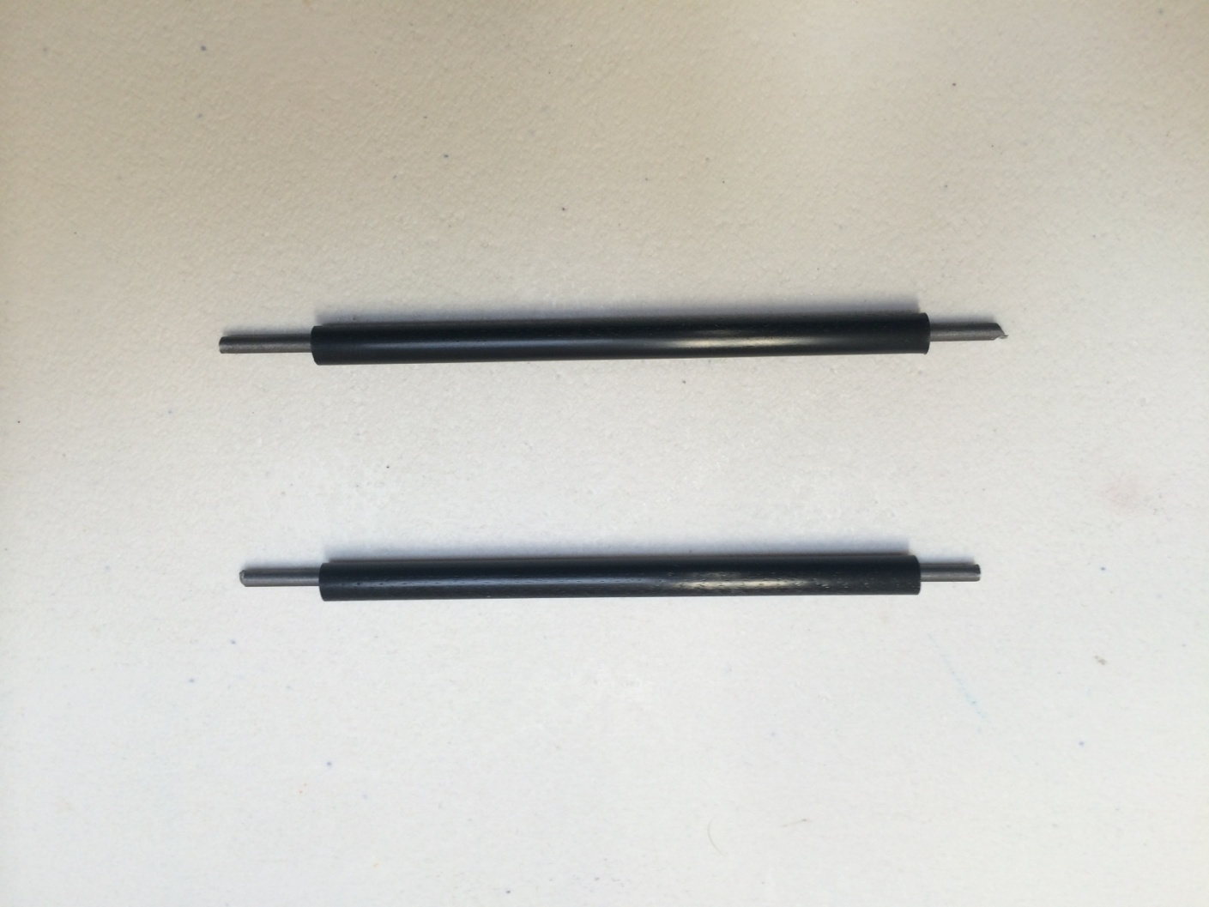
Insert metal rod into plastic straw.
This will act as the axle & shaft for your car.

Slide 7
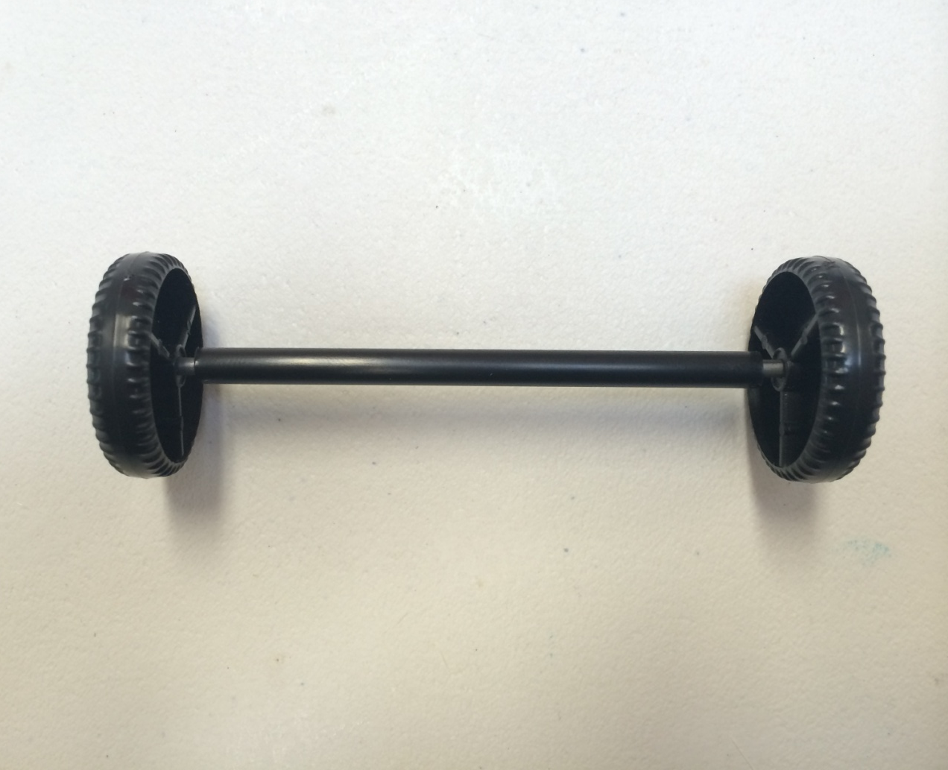
Attach both of the smaller Car Wheels onto the metal axle.
This will act as the front wheels of your car.

Slide 8
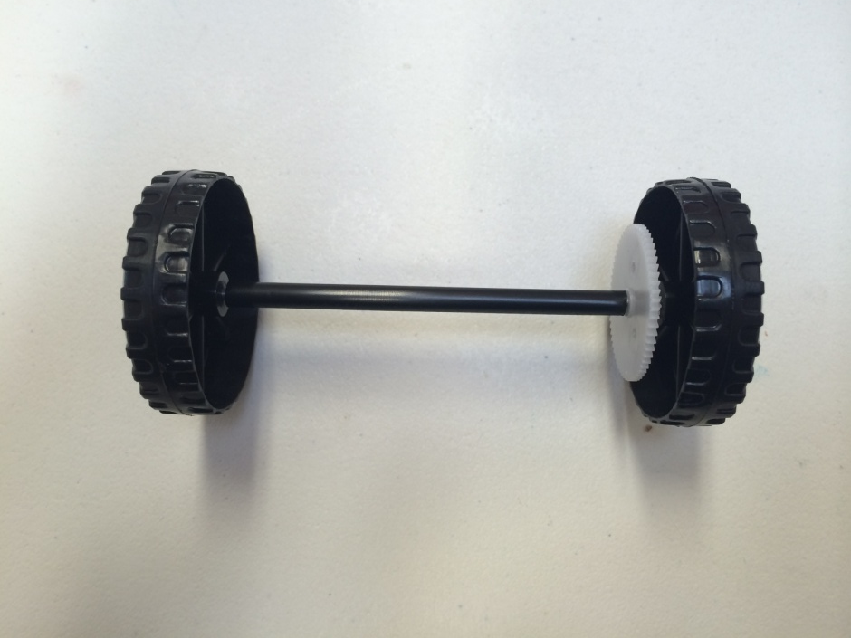
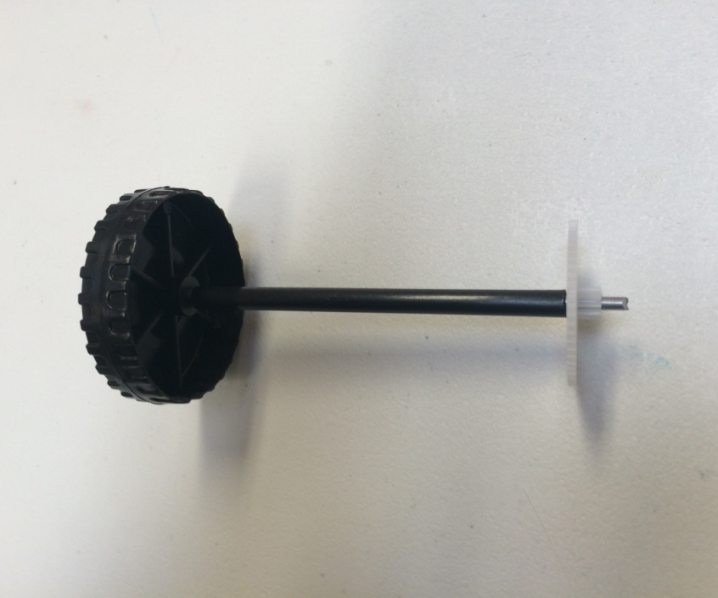
Attach one of the large Truck wheels onto the second metal axle.
Firmly press the white Spur Gear 60 Tooth onto the other end.
Then attach the final Truck Wheel over the Spur Gear.

Slide 9
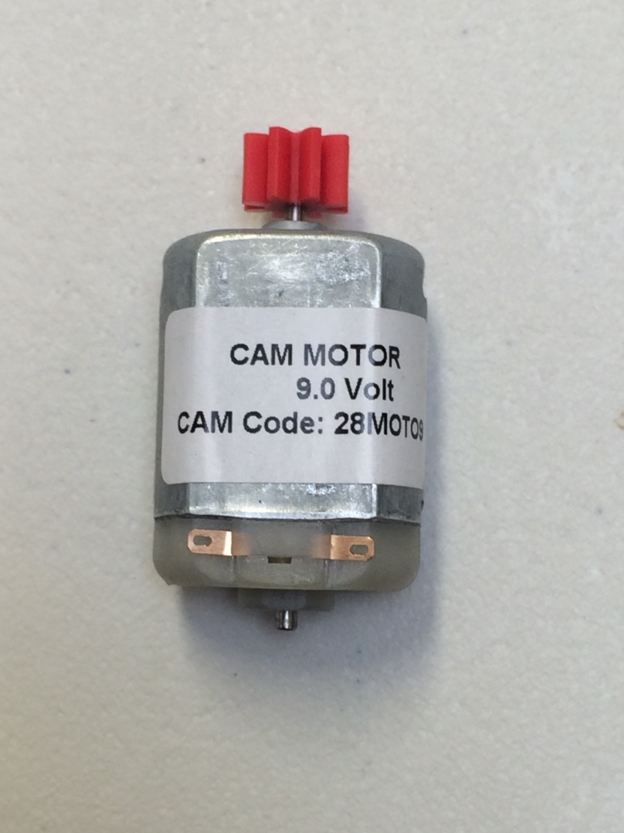
Attach the red Gear 8 Tooth onto the 9 Volt Flat Motor.

Slide 10
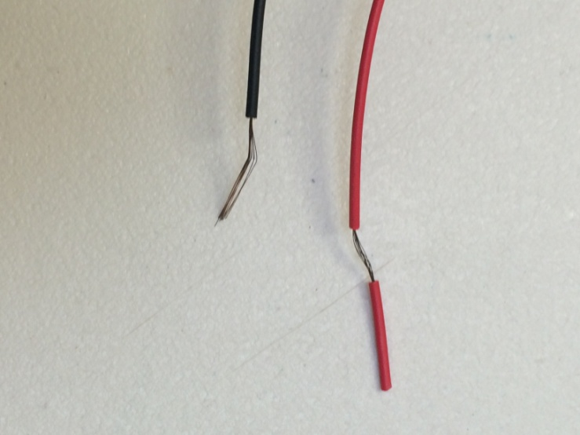
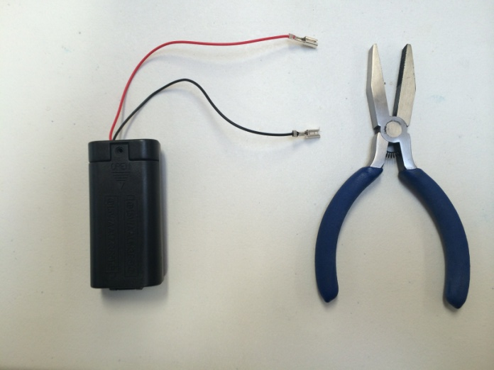
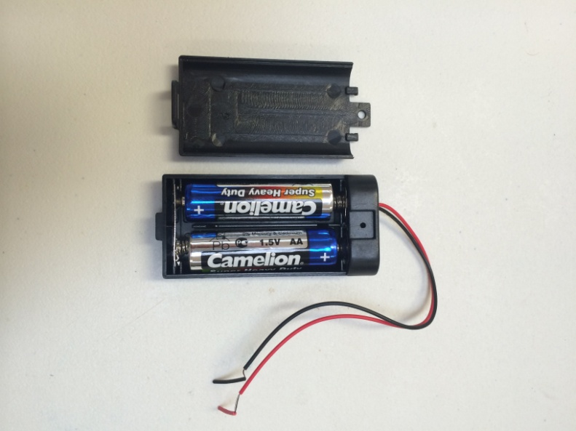
Insert both AA Batteries into the Battery Holder.
Remove plastic covers from the wire ends.
Place Connector Tabs over the wire ends & crimp with flat nose pliers.

Slide 11
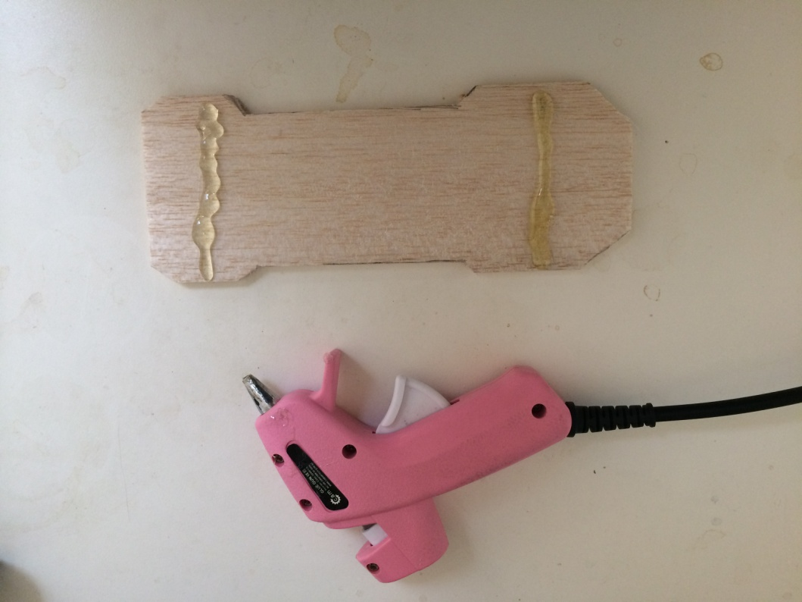
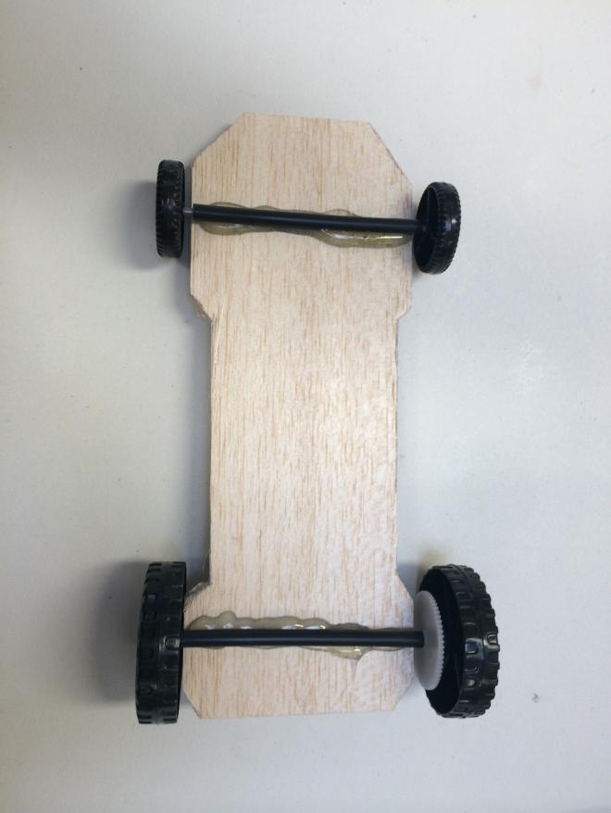
Use glue gun to attach Plastic Straw onto car base.
Align the straw in the centre of the wheel arch.
Repeat step for rear wheels.

Slide 12
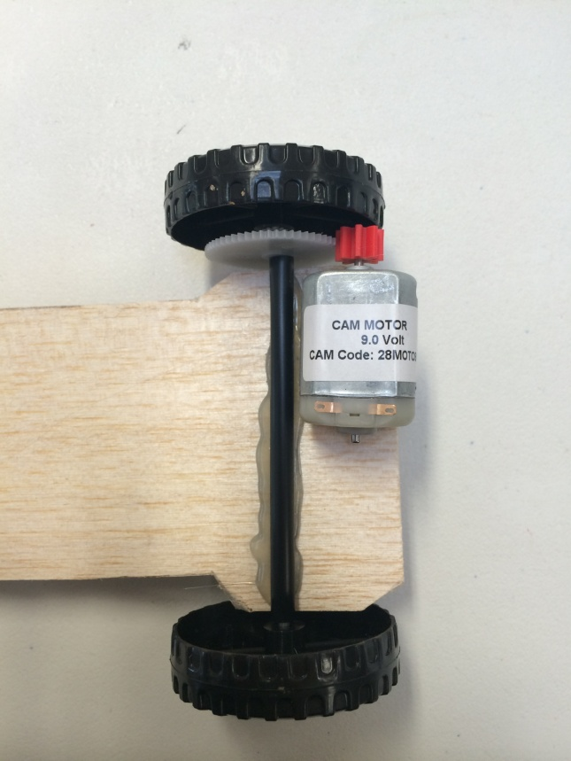
Glue motor into position behind rear wheel.
The red gear should lock in tightly with the white gear.
A good connection between the gears is pivotal to the cars ability to generate motion.

Slide 13
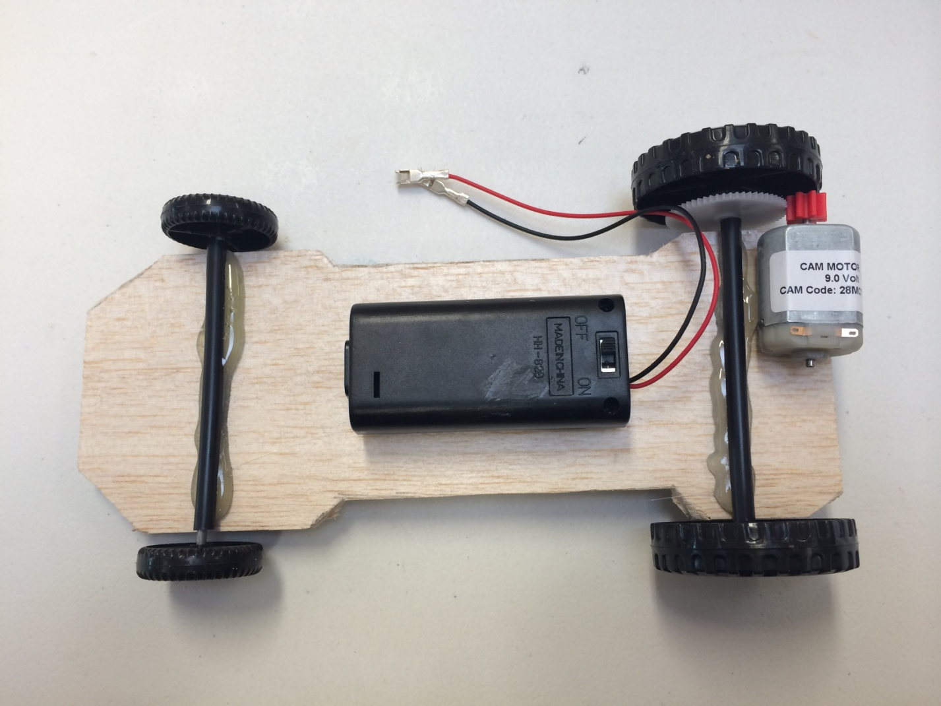
Glue Battery Holder onto the middle of the car base.
Make sure Off/On Switch is facing up.

Slide 14
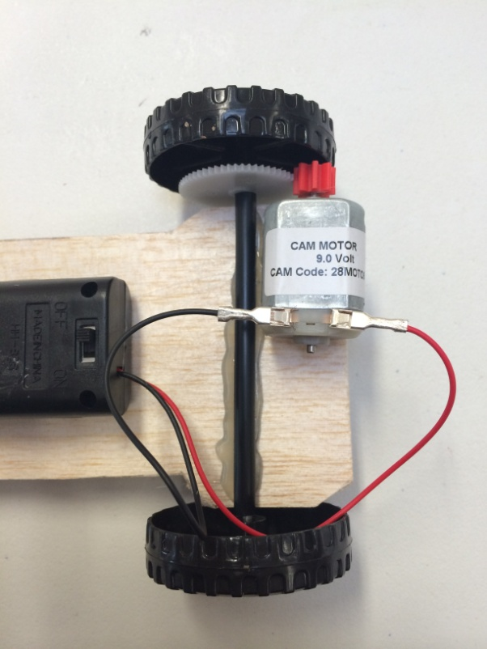
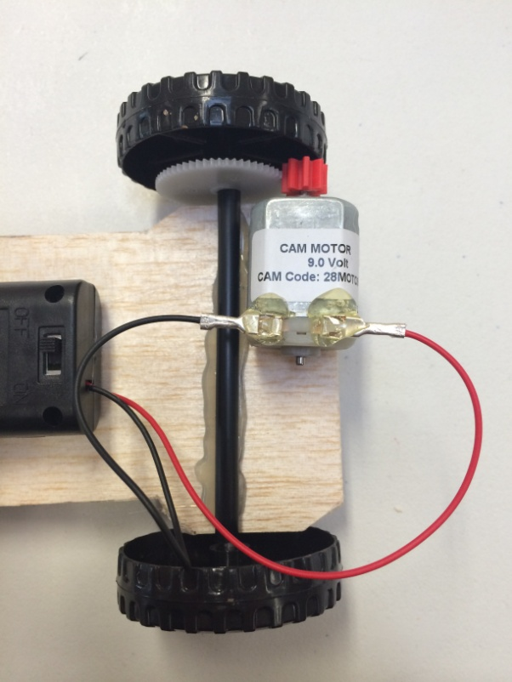
Attach Connector Tabs onto Motor
Test to make sure the car is travelling in the right direction.
May need to reverse wires on motor.
Glue Connector Tabs into place.
This will ensure they don’t slip off when in motion.

Slide 15
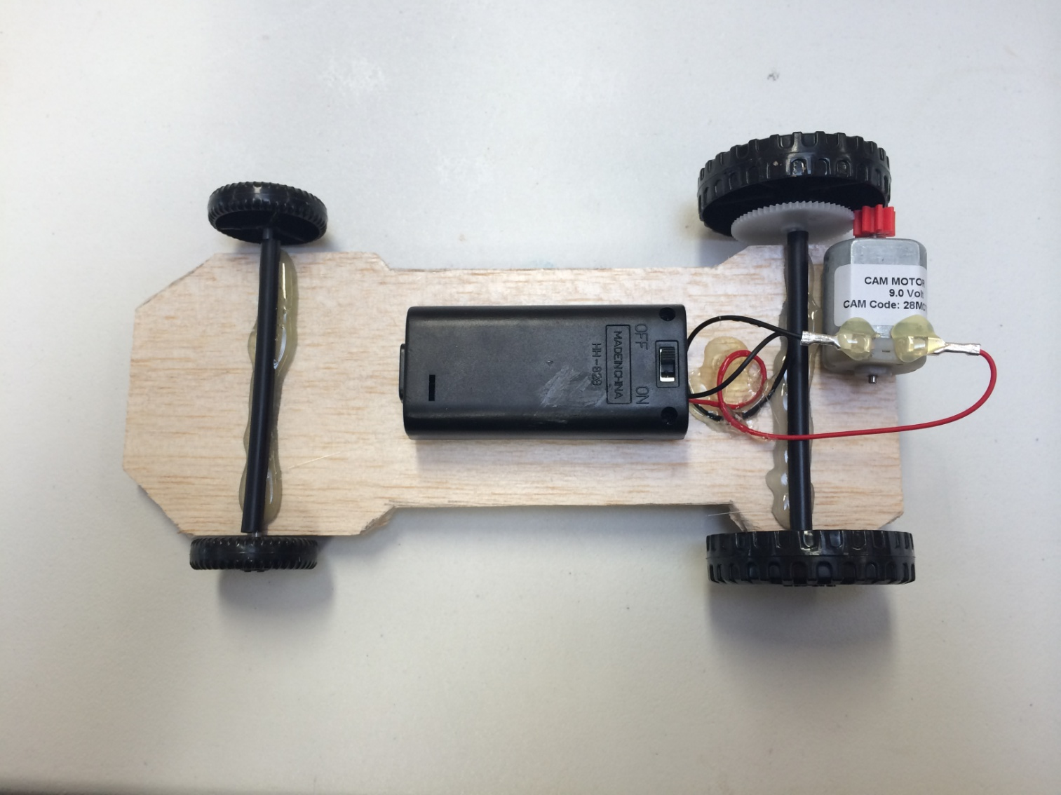
Glue excess wires to chassis for a tidy appearance.

Slide 16
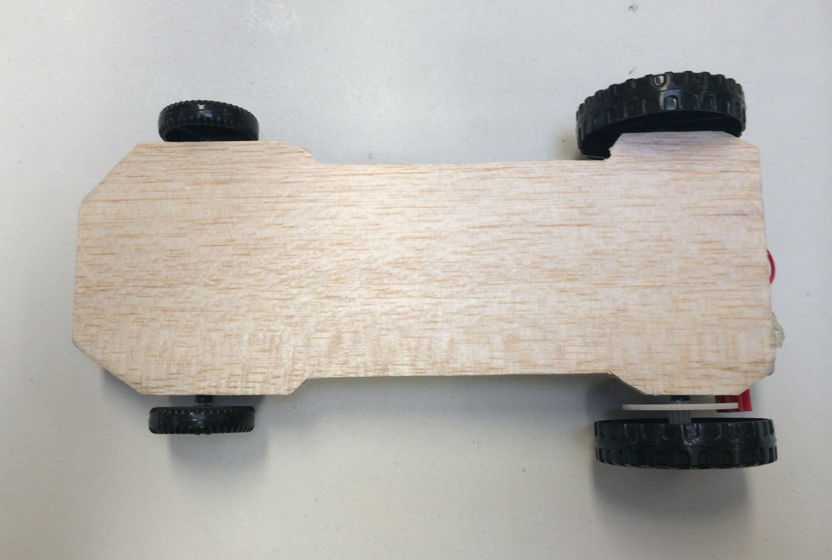
Flip over your car & it is ready to roll.

Slide 17
Decorate your car for a final bit of flare.
Hot Tip: Red cars go faster!!!

Slide 18
Turn the switch to the “On” position & away you go...

